Slide 1
Five days in Emilia-Romagna!
CATTOLICA
MODENA
RIMINI
PIACENZA
RICCIONE

Slide 2
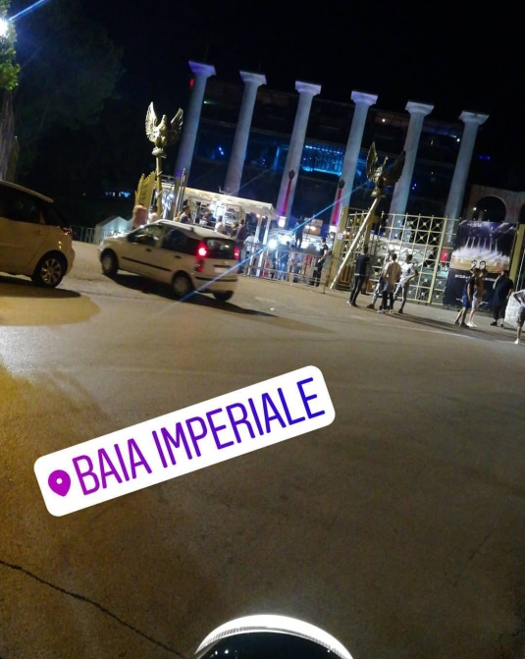
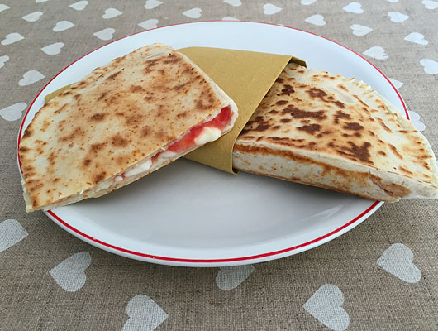
Cattolica
On the first day we settle in a waldorf palace hotel for 5 days at the turn of agust.
In the evening we go to dance at baia imperiale the most beautiful dance club of Italy.
At lunch we eat the specialties of emilia romagna, the piadina romagnola

Slide 3
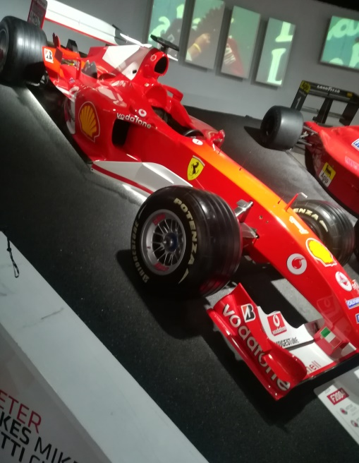
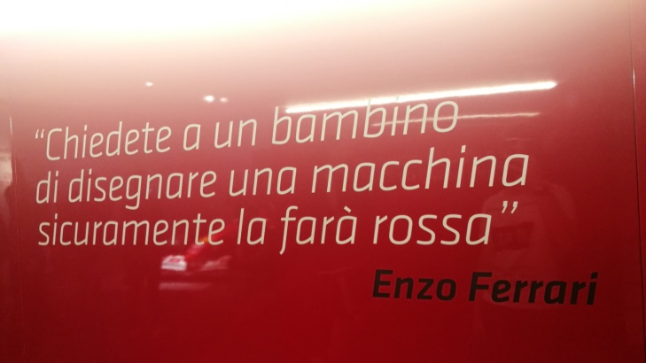
Modena
On the second day we go to Enzo Ferrari Museum, we watch all ferrari’s cars created until now days. We eat nex to the beautiful ferrari show!

Slide 4
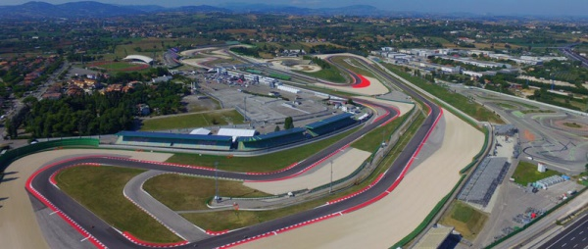
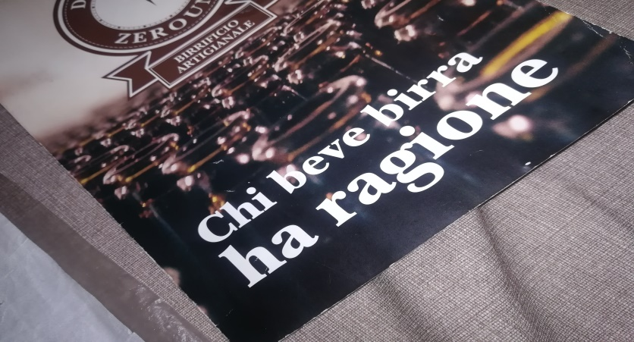
Riccione
On the third day, in the morning we go to on oltremare, that is a theme park, where we watch animols.
In the evening, we go to in Misano World Circuit Marco Simoncelli, it is named in memory of Simoncelli an italian motocyclist who died in 2011
If you want take a ride with the
go-kart.
If you wont go to hops where you can drink craft beer.

Slide 5
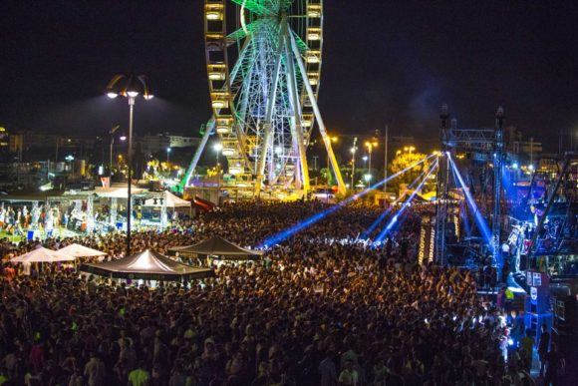
Rimini
On 4° day, if you want go on italia in miniatura it is a fun theme park!
Rimini is well known for its famous and lively night nightlife that should not be underestimated!!!

Slide 6
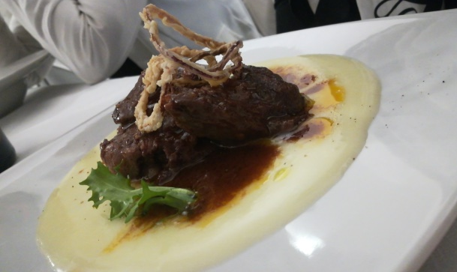
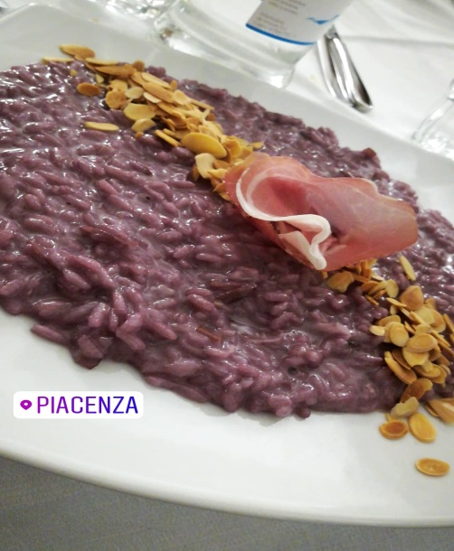
Piacenza
Last but not least are Piacenza, the beautiful city not to be missed. It is a historical city.
I would recommend going to Osteria Carducci downtown, where they cook tipical dish.

