Slide 1
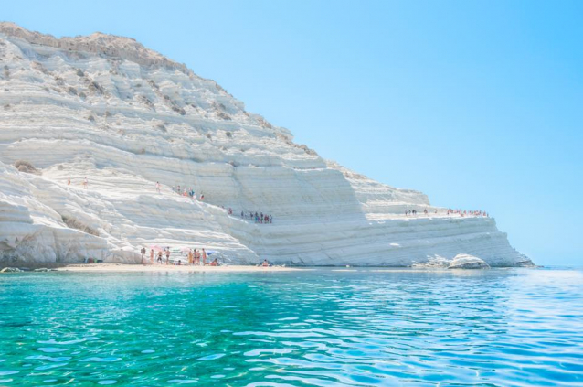
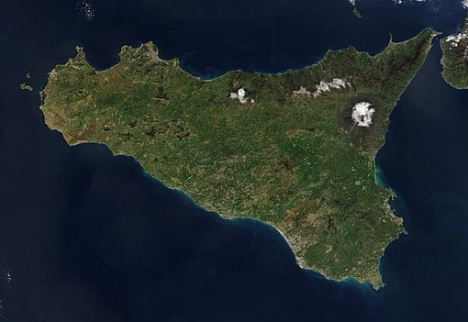
SICILY
Is the largest island in the Mediterranean sea and one of 20 region of Italy. Is one of five italian autonomous region.

Slide 2
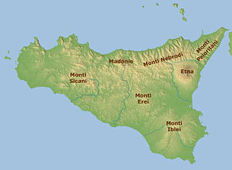
GEOGRAPHY
Sicily has a roughly triangular shape, earning it the name Trinacria. The terrain of inland Sicily is mostly hilly and is intensively cultivated wherever possible
Along the northern coast , the mountain range are the an extension of the Appennini.
The cone of Etna dominates the eastern coast .
In the southwest we have the Monti Sicani
In the southeast lie to the lower Monti Iblei and Erei

Slide 3
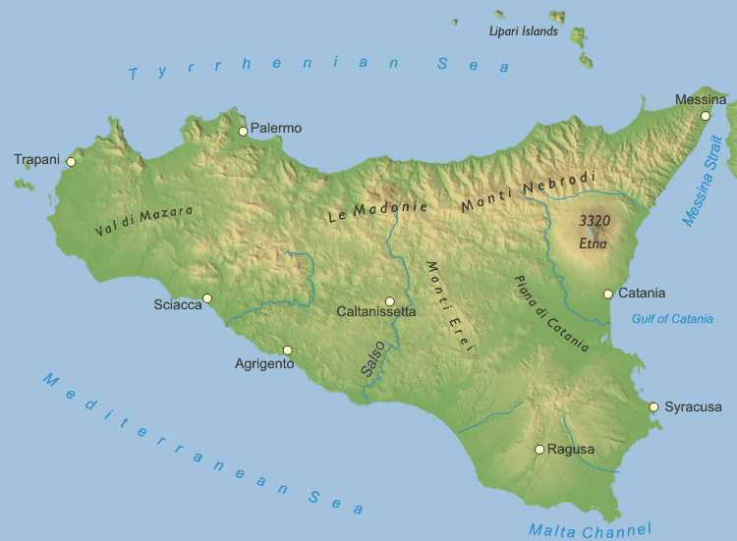
The island is drained by several rivers, most of which flow through the central area and enter the sea at the south of the island
To the east, the Alcantara flows through the province of Messina and enters the sea at Giardini Naxos, and the Simeto, which flows into the Ionian Sea south of Catania
The Salso flows through parts of Enna and Caltanissetta before entering the Mediterranean Sea at the port of Licata
Other important rivers on the island are the Belice and Platani in the southwest

Slide 4
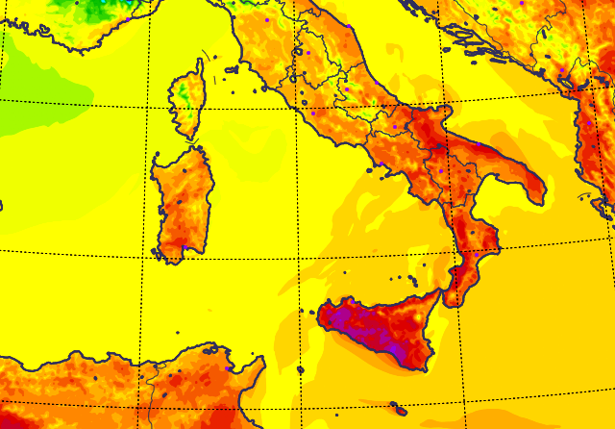
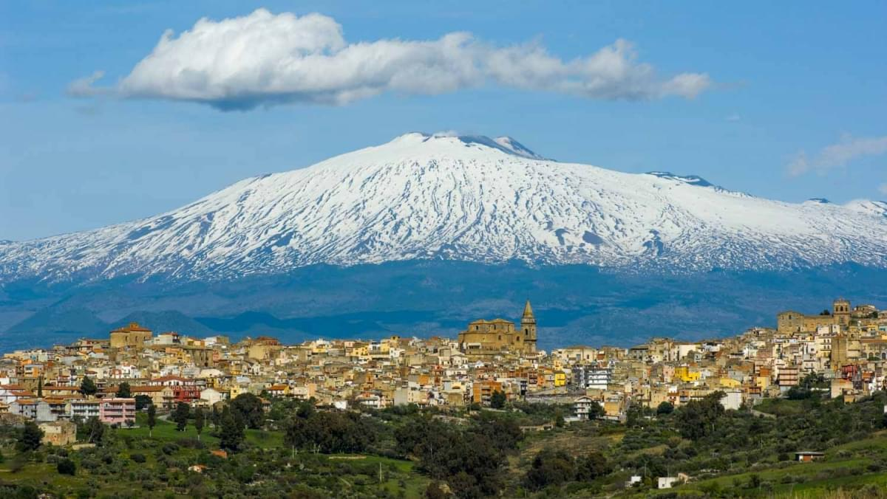
Sicily has a typical Mediterranean climate with mild and wet winters and hot, dry summers with very changeable intermediate seasons. On the coasts, especially the south-western, the climate is affected by the African currents and summers can be scorching. Rainfall is scarce, and water proves deficient in some provinces where water crisis can happen sometimes

Slide 5
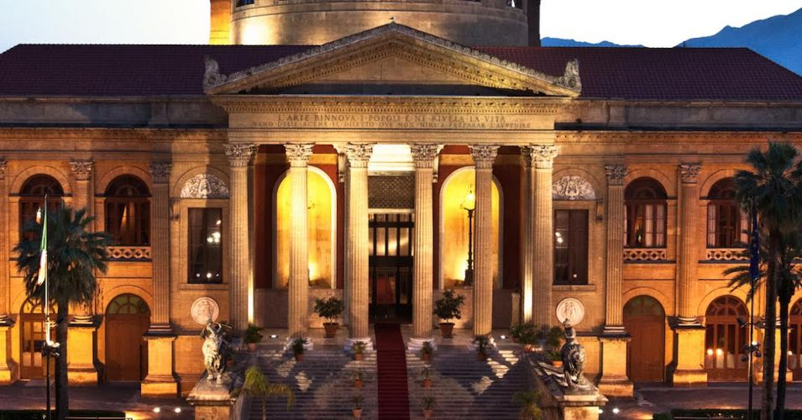
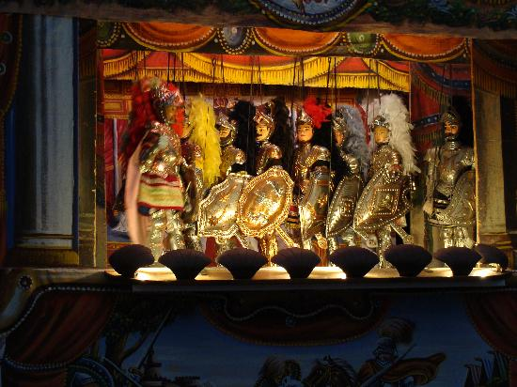
PALERMO
Teatro Massimo http://www.teatromassimo.it/
Museo delle Marionette https://www.museodellemarionette.it/index.php?lang=it

Slide 6
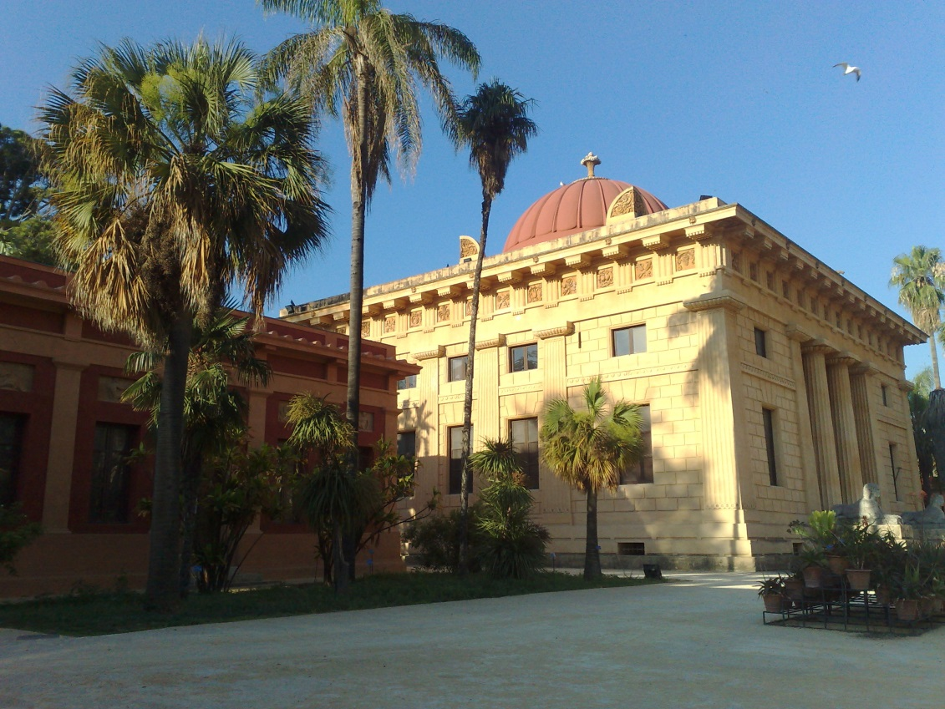
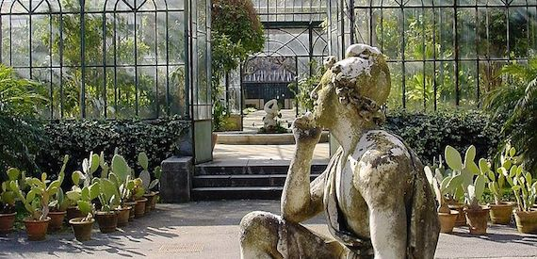
Orto Botanico
http://www.ortobotanico.unipa.it/

Slide 7
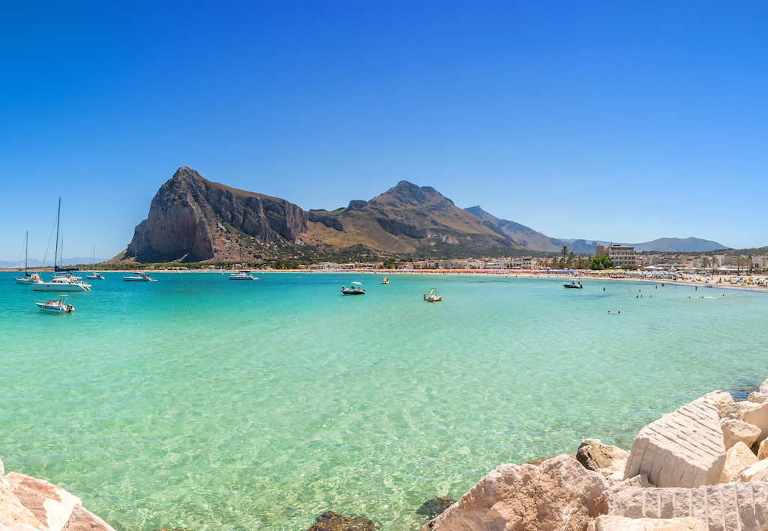
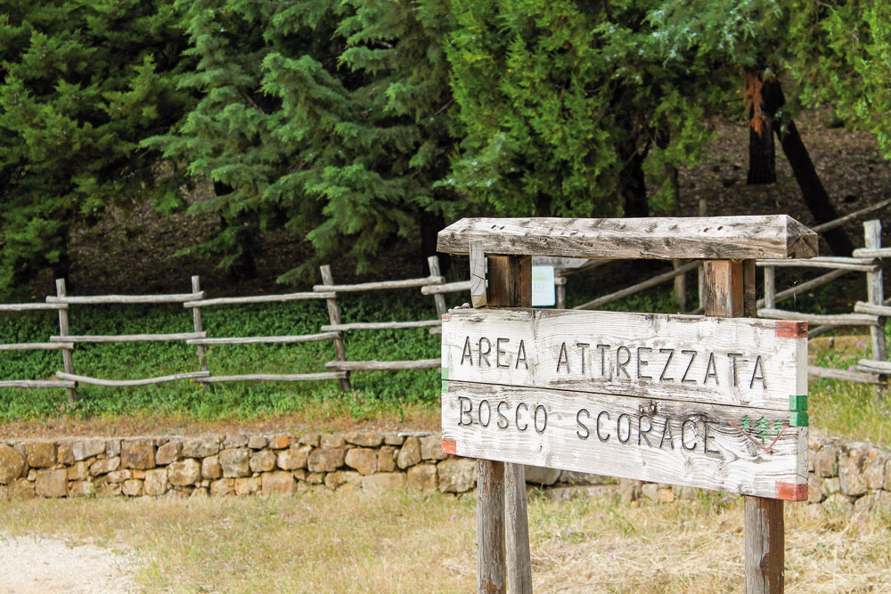
TRAPANI
San Vito lo Capo https://www.sanvitolocapo.com/
Bosco Scorace http://www.turismo.trapani.it/it/1078/bosco-scorace-d-arcudaci.html

Slide 8
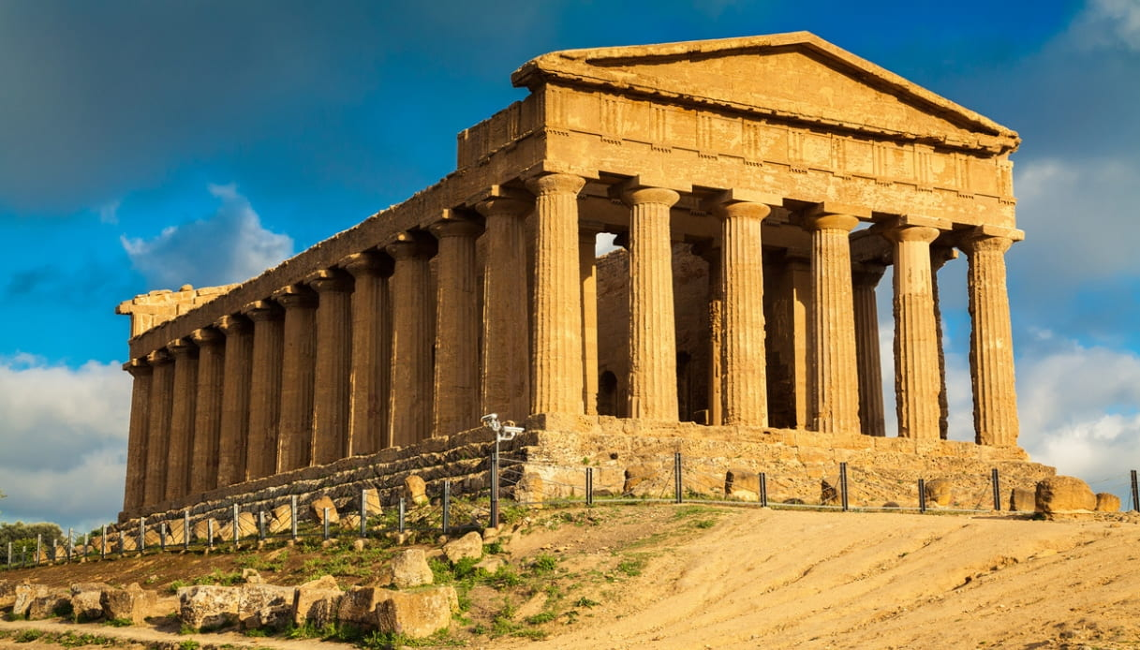
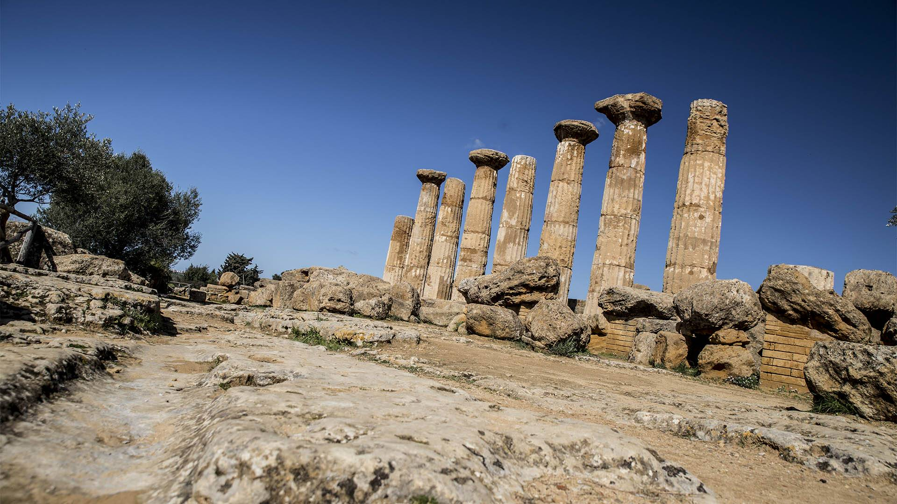
AGRIGENTO
Valle dei Templi https://www.lavalledeitempli.it/

Slide 9
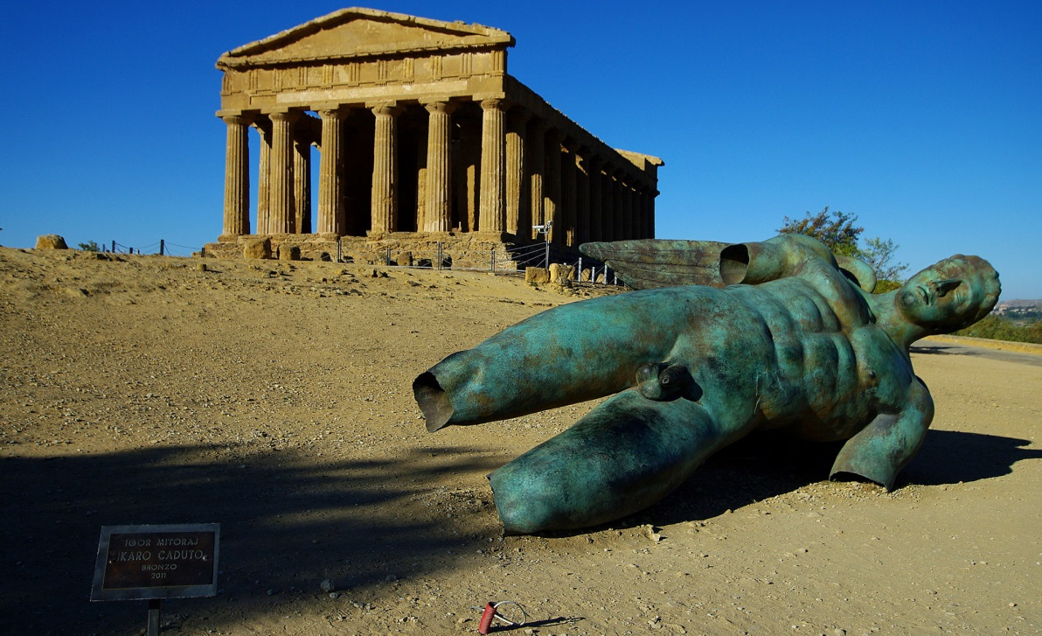
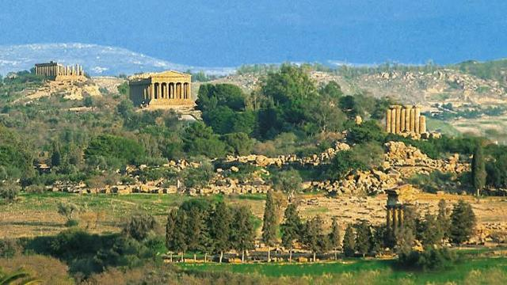

Slide 10
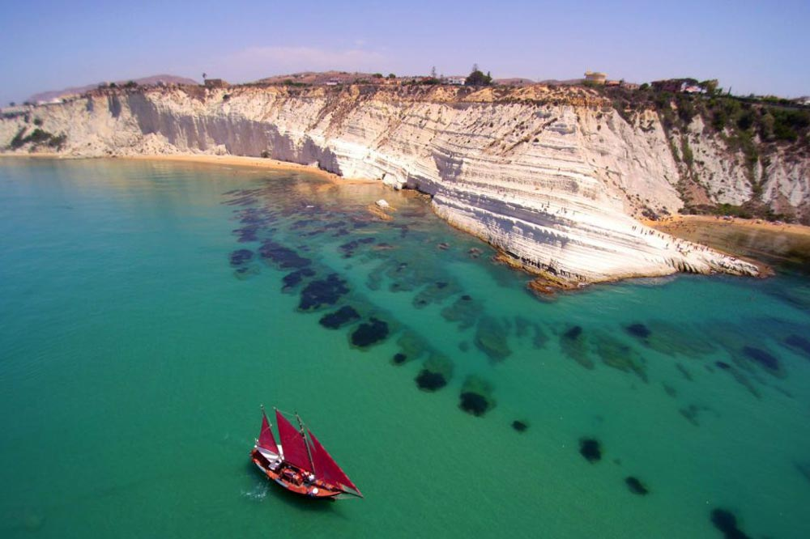
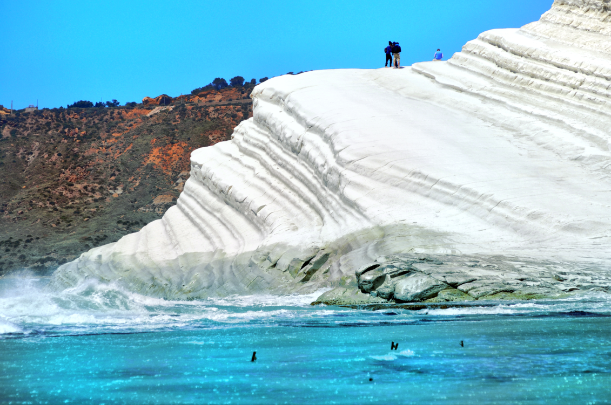
Scala dei Turchi http://www.girasicilia.it/la-scala-dei-turchi-realmonte-mare-sicilia/

Slide 11
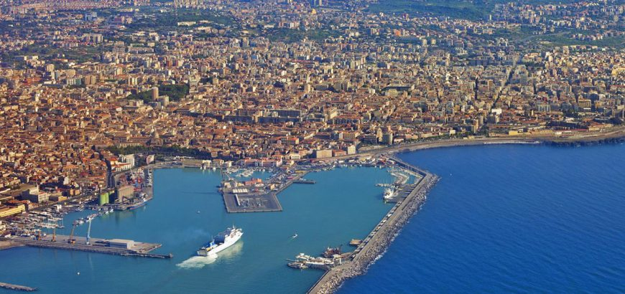
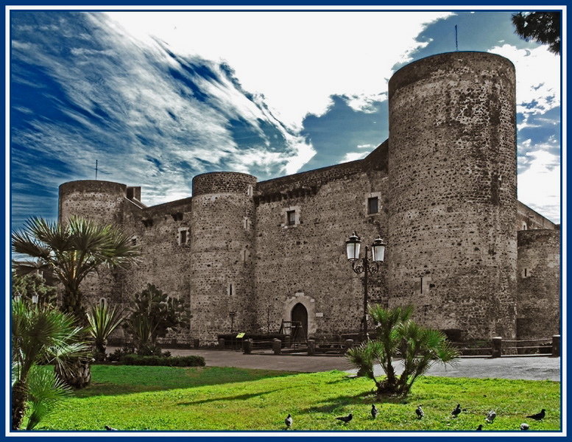
CATANIA
Catello Ursino https://www.peripericatania.it/cosa-vedere/castello-ursino-2/

Slide 12
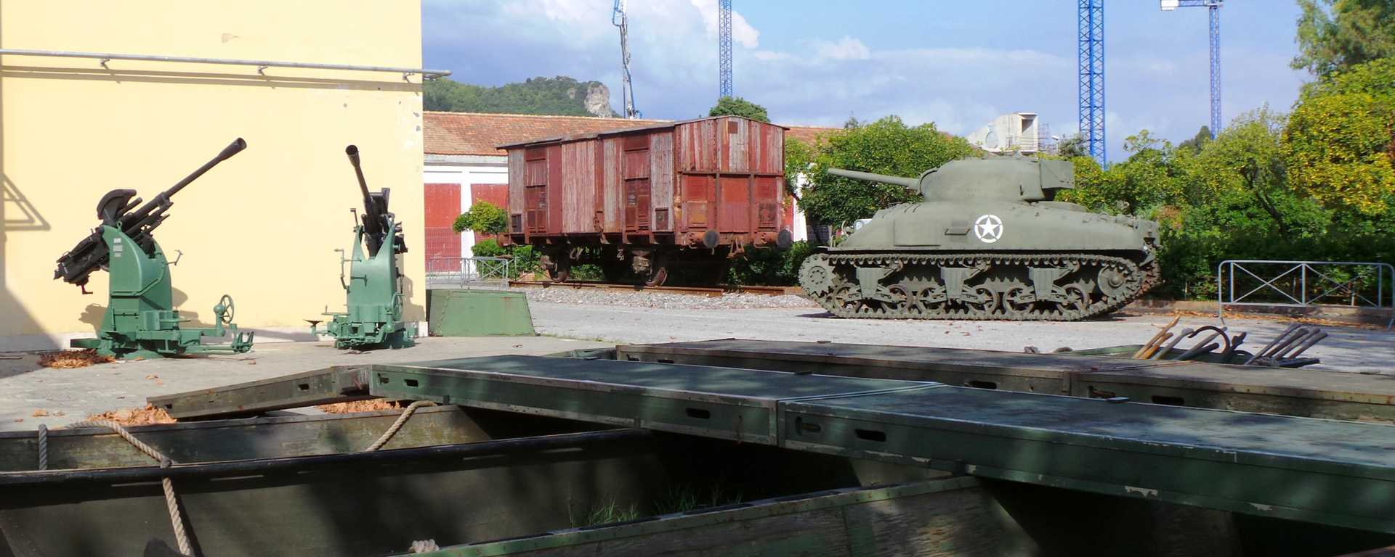
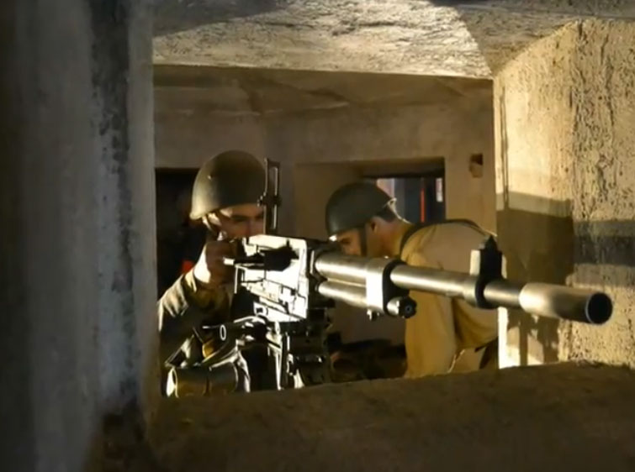
The Historical Museum of the Landing

Slide 13
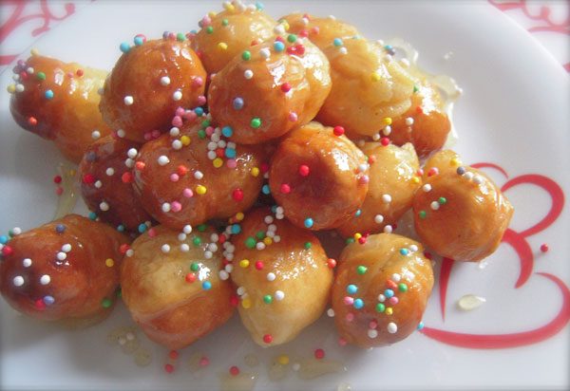
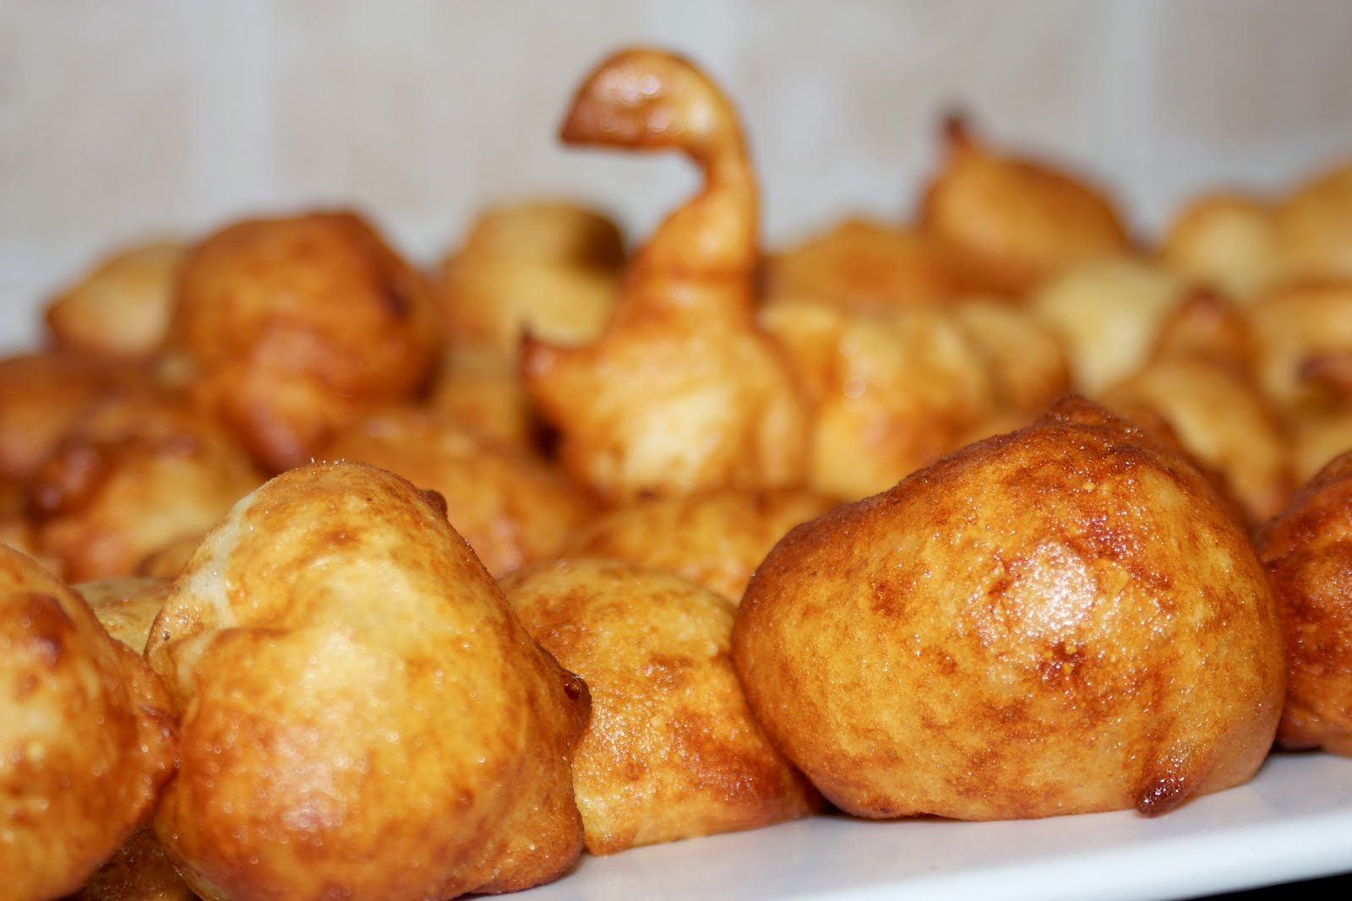
FOOD
La Pignulata
Chiddu chi cci voli
6 ova
500 gr farina bianca 00 ( e chidda chi piglia)
6 cucchiarati d’ogliu d’aliva
Ogliu oi frijri
Meli e diavulicchi.
Sfinci di patati
Chiddu chi cci voli
600 gr di patati
500gr di farina
¼ di litru di latti
4 ova
Un pizzicu di sali e di cannedda
50 gr di levitu di birra
Ogliu abbunnatu pi frijri

Slide 14
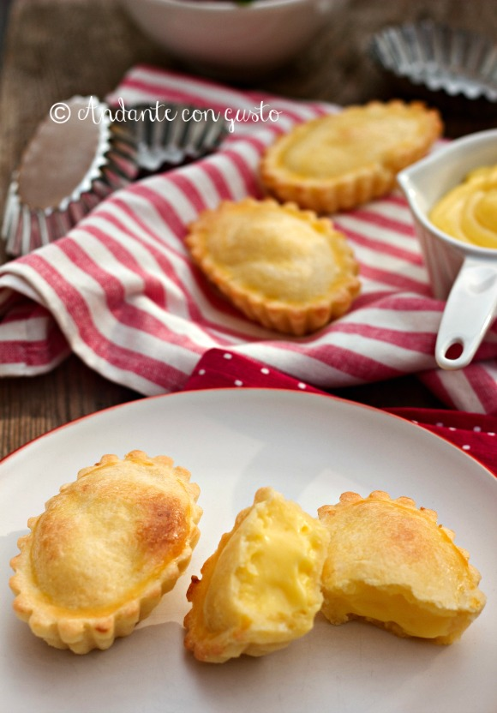
Pasticciotta cu marmellata di citru
Chiddu chi cci voli
1 kg farina
300 gr di zuccaru
200 gr di saimi
30 gr d’ammoniaca
2 bustini di levitu e 1 di vaniglia
4 ova
Latti quantu basta

